Slide 1
Multilevel Indexes

Slide 2
Multi-Level Indexes
Because a single-level index is an ordered file, we can create a primary index to the index itself ; in this case, the original index file is called the first-level index and the index to the index is called the second-level index.
We can repeat the process, creating a third, fourth, ..., top level until all entries of the top level fit in one disk block
A multi-level index can be created for any type of first-level index (primary, secondary, clustering) as long as the first-level index consists of more than one disk block

Slide 3
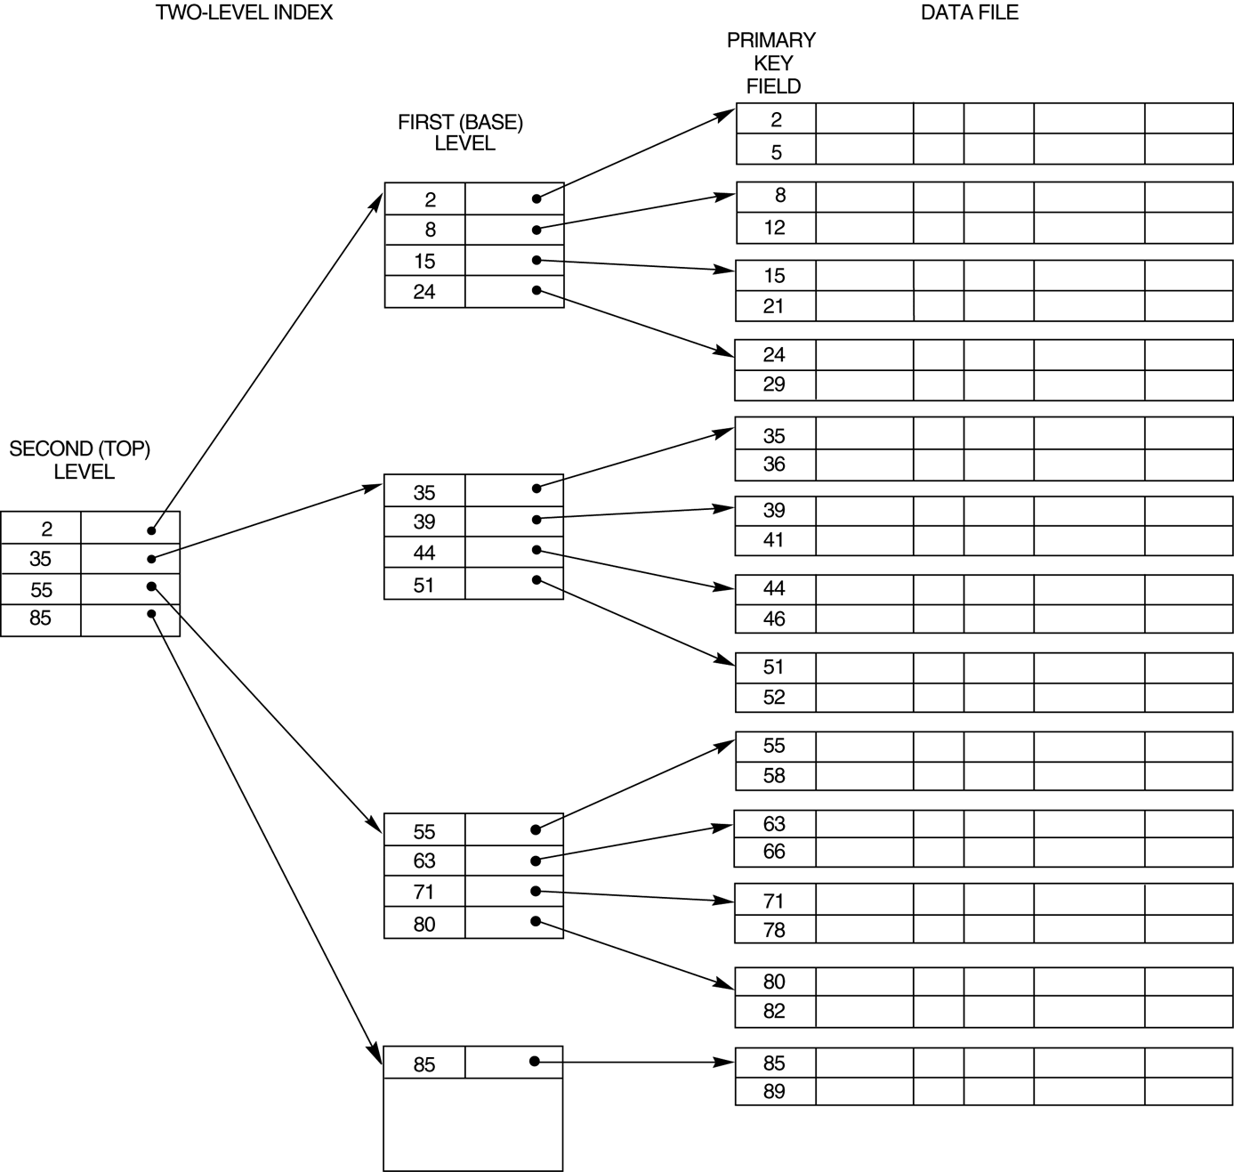
FIGURE 14.6 A two-level primary index resembling ISAM (Indexed Sequential Access Method) organization.

Slide 4
A binary search requires approximately (log2 bi) block accesses for an index with bi blocks.
The idea behind a multilevel index is to reduce the part of the index that we continue to search by bfri, the blocking factor for the index, which is larger than 2.
The value bfri is called the fan-out of the multilevel index, and we will refer to it by the symbol fo.
Searching a multilevel index requires approximately (logfo bi) block accesses, which is a substantially smaller number than for a binary search if the fan-out is larger than 2.
To retain the benefits of using multilevel indexing while reducing index insertion and deletion problems, designers adopted a multilevel index called a dynamic multilevel index that leaves some space in each of its blocks for inserting new entries and uses appropriate insertion/deletion algorithms for creating and deleting new index blocks when the data file grows and shrinks.
It is often implemented by using data structures called B-trees and B+-trees,

Slide 5
Multi-Level Indexes
Such a multi-level index is a form of search tree ; however, insertion and deletion of new index entries is a severe problem because every level of the index is an ordered file.

Slide 6
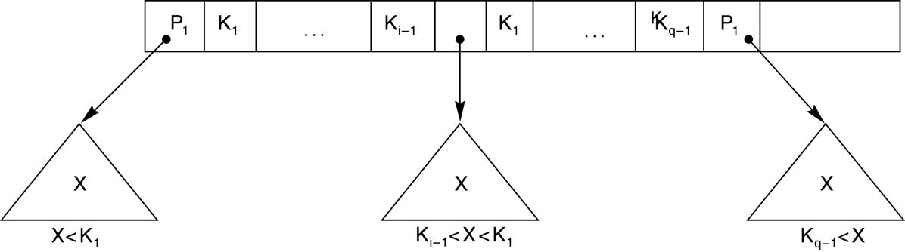
A node in a search tree with pointers to subtrees below it.

Slide 7
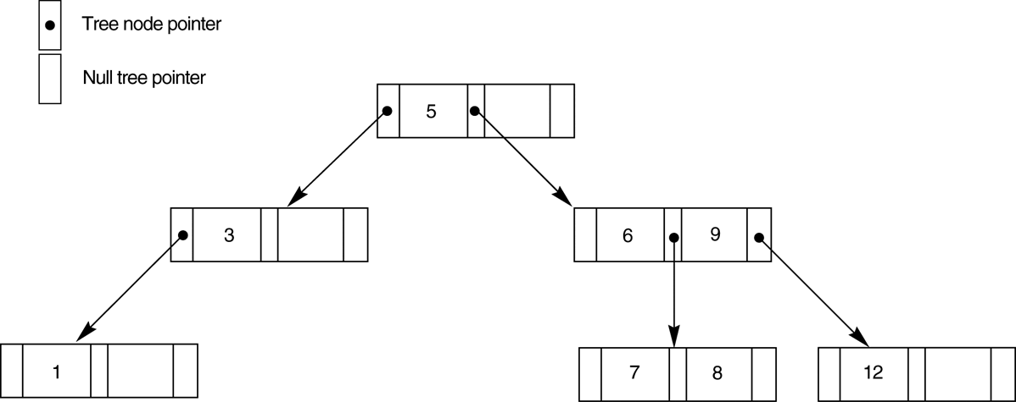
A search tree of order p = 3.
A search tree of order p is a tree such that each node contains at most p − 1 search
values and p pointers in the order <P1, K1, P2, K2, … , Pq−1, Kq−1, Pq>, where q ≤ p.
Each Pi is a pointer to a child node (or a NULL pointer), and each Ki is a search
value from some ordered set of values.
The search tree itself can be stored on disk by assigning each tree node to a disk block.

Slide 8
The goals for balancing a search tree are as follows:
To guarantee that nodes are evenly distributed, so that the depth of the tree is minimized for the given set of keys and that the tree does not get skewed with some nodes being at very deep levels
To make the search speed uniform, so that the average time to find any random key is roughly the same
To make sure that the index tree does not need too much restructuring as records are inserted into and deleted from the main file.

Slide 9
Dynamic Multilevel Indexes Using B-Trees and B+-Trees
Because of the insertion and deletion problem, most multi-level indexes use B-tree or B+-tree data structures, which leave space in each tree node (disk block) to allow for new index entries
These data structures are variations of search trees that allow efficient insertion and deletion of new search values.
In B-Tree and B+-Tree data structures, each node corresponds to a disk block
Each node is kept between half-full and completely full

Slide 10
Dynamic Multilevel Indexes Using B-Trees and B+-Trees (contd.)
An insertion into a node that is not full is quite efficient; if a node is full the insertion causes a split into two nodes
Splitting may propagate to other tree levels
A deletion is quite efficient if a node does not become less than half full
If a deletion causes a node to become less than half full, it must be merged with neighboring nodes

Slide 11
Difference between B-tree and B+-tree
In a B-tree, pointers to data records exist at all levels of the tree
In a B+-tree, all pointers to data records exists at the leaf-level nodes
A B+-tree can have less levels (or higher capacity of search values) than the corresponding B-tree

Slide 12
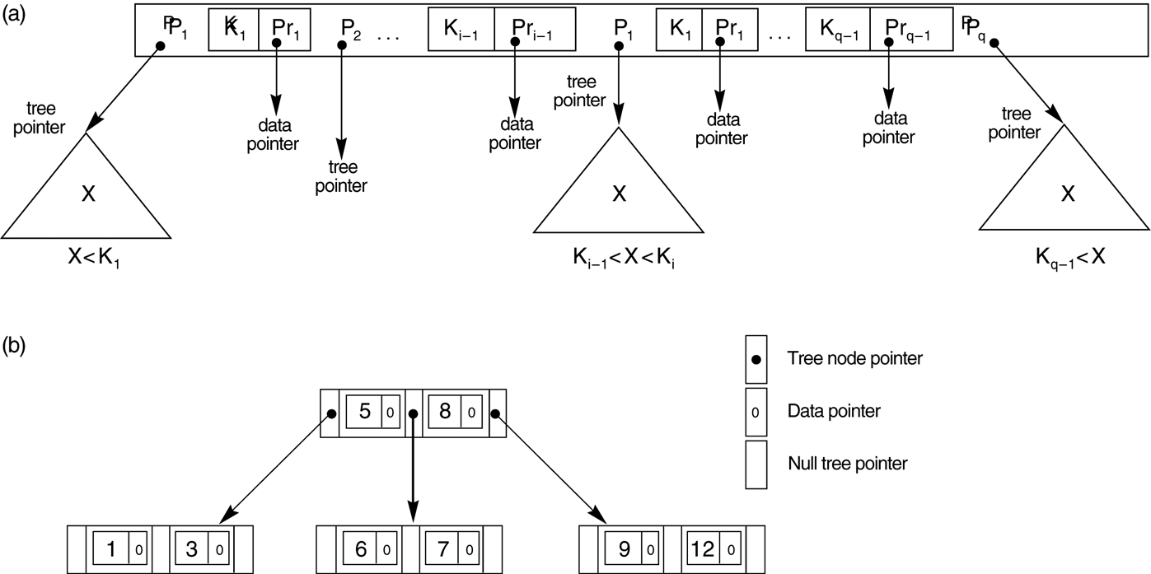
B-tree structures. (a) A node in a B-tree with q – 1 search values. (b) A B-tree of order p = 3. The values were inserted in the order 8, 5, 1, 7, 3, 12, 9, 6.

Slide 13
A B-tree starts with a single root node (which is also a leaf node) at level 0 (zero).
Once the root node is full with p − 1 search key values and we attempt to insert another entry in the tree, the root node splits into two nodes at level 1.
Only the middle value is kept in the root node, and the rest of the values are split evenly between the other two nodes.
When a non-root node is full and a new entry is inserted into it, that node is split into two nodes at the same level, and the middle entry is moved to the parent node along with two pointers to the new split nodes.
If the parent node is full, it is also split.
Splitting can propagate all the way to the root node, creating a new level if the root is split.

Slide 14
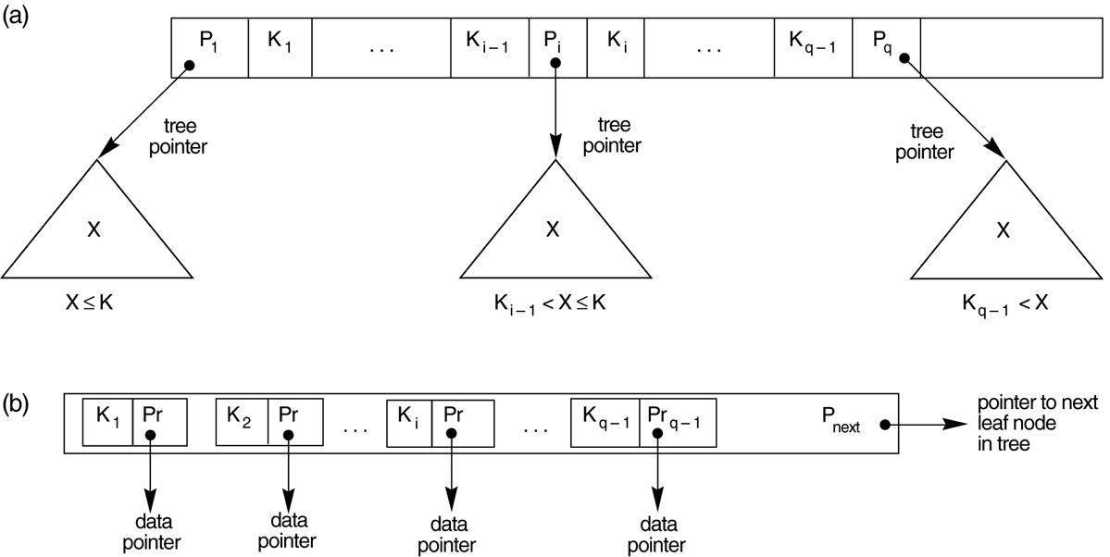
FIGURE 14.11 The nodes of a B+-tree. (a) Internal node of a B+-tree with q –1 search values. (b) Leaf node of a B+-tree with q – 1 search values and q – 1 data pointers.

Slide 15
The structure of the internal nodes of a B+-tree of order p is as follows:
Each internal node is of the form <P1, K1, P2, K2, … , Pq − 1, Kq −1, Pq>
where q ≤ p and each Pi is a tree pointer.
Within each internal node, K1 < K2 < … < Kq−1.
For all search field values X in the subtree pointed at by Pi, we have Ki−1 < X≤ Ki
for 1 < i < q; X ≤ Ki for i = 1; and Ki−1 < X for i = q
Each internal node has at most p tree pointers.
Each internal node, except the root, has at least ⎡(p/2)⎤ tree pointers.
The root node has at least two tree pointers if it is an internal node.
An internal node with q pointers, q ≤ p, has q − 1 search field values.

Slide 16
The structure of the leaf nodes of a B+-tree of order p) is as follows:
1. Each leaf node is of the form <<K1, Pr1>, <K2, Pr2>, … , <Kq−1, Prq−1>, Pnext> where q ≤ p, each Pri is a data pointer, and Pnext points to the next leaf node of the B+-tree.
2. Within each leaf node, K1 ≤ K2 … , Kq−1, q ≤ p.
3. Each Pri is a data pointer that points to the record whose search field value is Ki or to a file block containing the record (or to a block of record pointers that point to records whose search field value is Ki if the search field is not a key).
4. Each leaf node has at least ⎡(p/2)⎤ values.
5. All leaf nodes are at the same level.

Slide 17
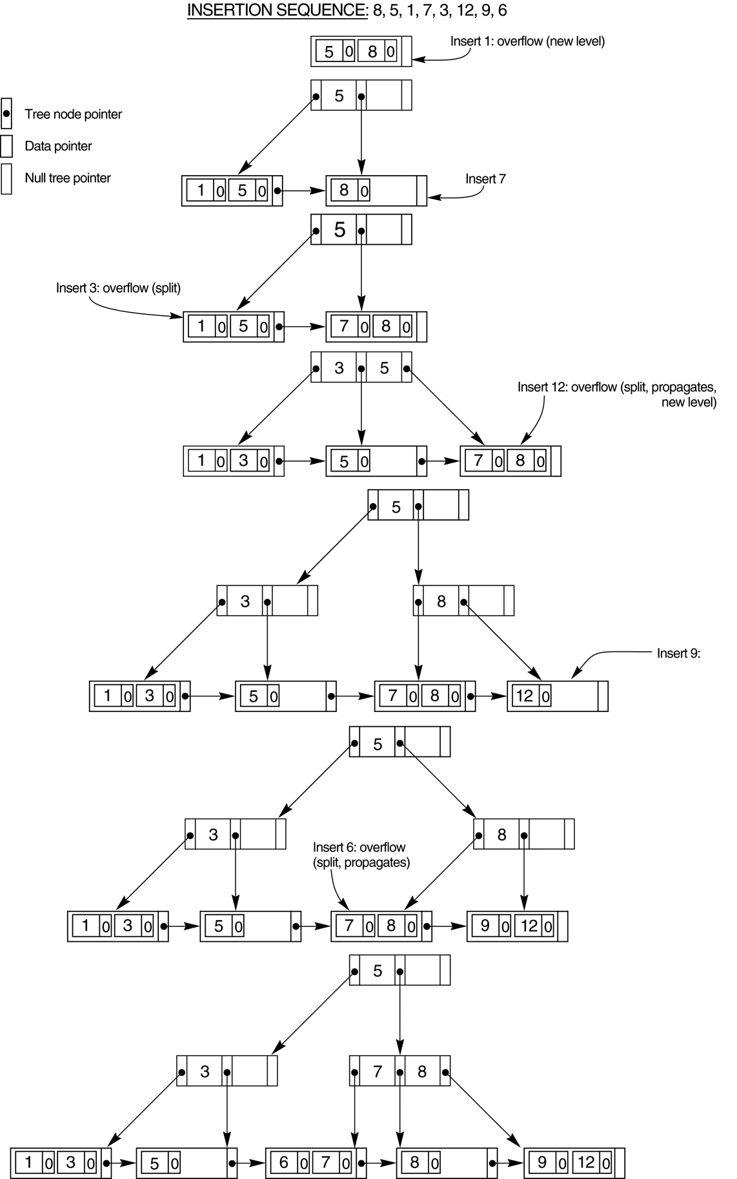
An example of insertion in a B+-tree with q = 3 and p_{leaf} = 2.

Slide 18
When a leaf node is full and a new entry is inserted there, the node overflows and must be split.
The first j = ⎡((pleaf + 1)/2)⎤ entries in the original node are kept there,and the remaining entries are moved to a new leaf node.
The jth search value is replicated in the parent internal node, and an extra pointer to the new node is created in the parent. These must be inserted in the parent node in their correct sequence.
If the parent internal node is full, the new value will cause it to overflow
also, so it must be split.
The entries in the internal node up to Pj—the jth tree pointer after inserting the new value and pointer, where j = ⎣((p + 1)/2)⎦—are kept, whereas the jth search value is moved to the parent, not replicated.
A new internal node will hold the entries from Pj+1 to the end of the entries in the node .
This splitting can propagate all the way up to create a new root node and hence a new level for the B+-tree.

Slide 19
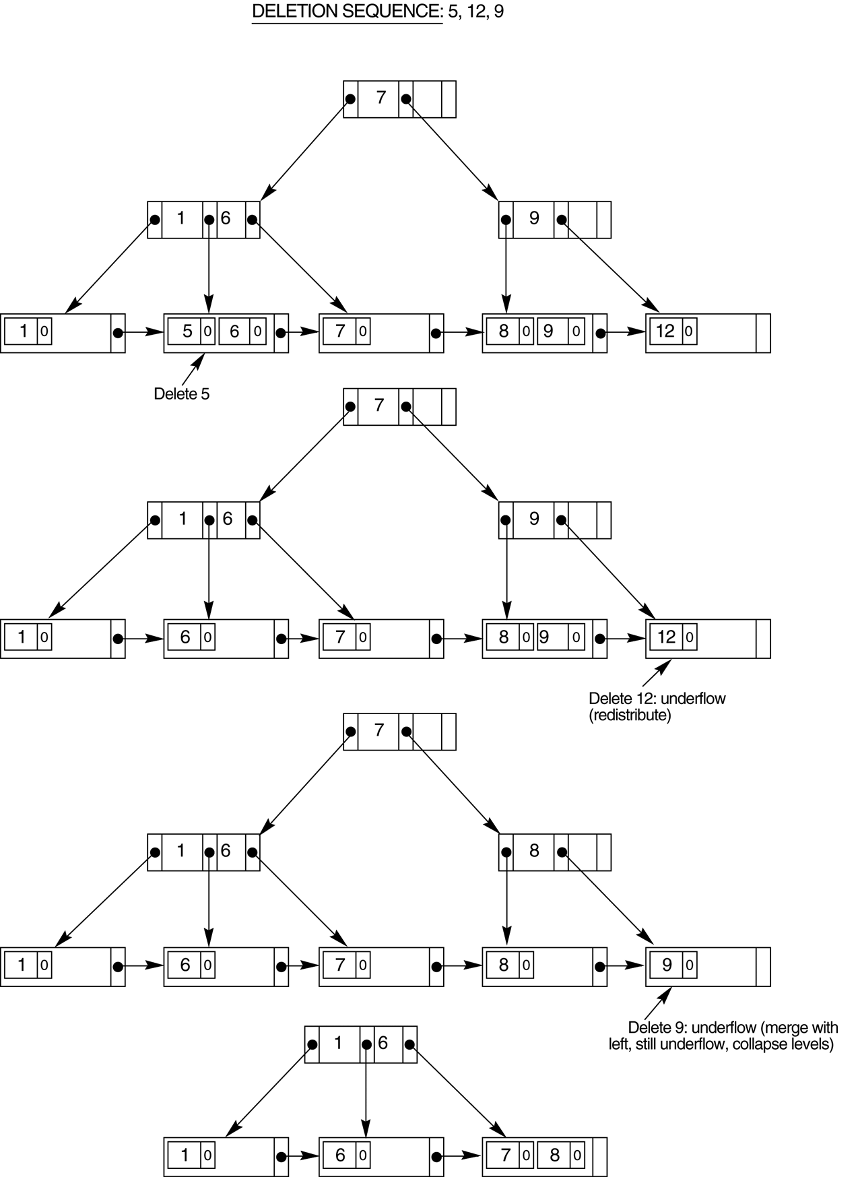
An example of deletion from a B+-tree.

Slide 20
When an entry is deleted, it is always removed from the leaf level. If it happens to occur in an internal node, it must also be removed from there.
In the latter case, the value to its left in the leaf node must replace it in the internal node because that value is now the rightmost entry in the subtree.
Deletion may cause underflow by reducing the number of entries in the leaf node to below the minimum required. In this case, we try to find a sibling leaf node—a leaf node directly to the left or to the right of the node with underflow—and redistribute the entries among the node and its sibling so that
both are at least half full; otherwise, the node is merged with its siblings and the
number of leaf nodes is reduced.
A common method is to try to redistribute entries with the left sibling; if this is not possible, an attempt to redistribute with the right sibling is made.
If this is also not possible, the three nodes are merged into two leaf nodes.
In such a case, underflow may propagate to internal nodes because one fewer tree pointer and search value are needed.
This can propagate and reduce the tree levels.

